Slide 1

LOAN BOOK ANALYSIS
(Principal Balance)
Prepared by Martin Wambugu

Slide 2
THANK YOU

Slide 3

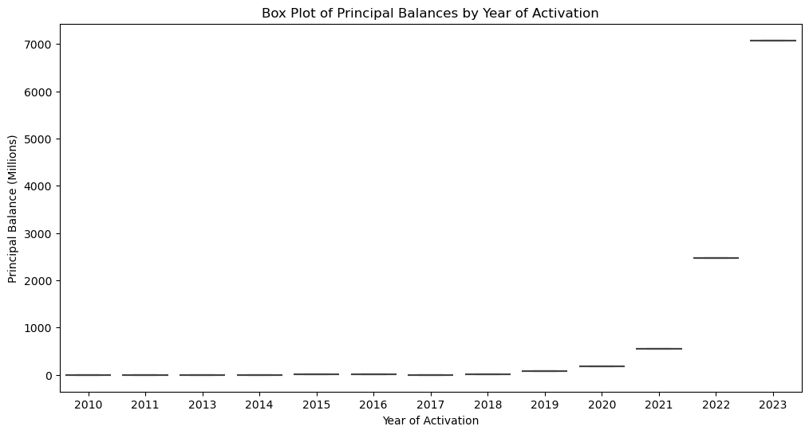
Box plot for 'Principal Balance' To show the trend of principle balances from 2010 to 2023 - the plot indicates that the company has been on an upward trajectory which is a good sign for the company to invest more.

Slide 4
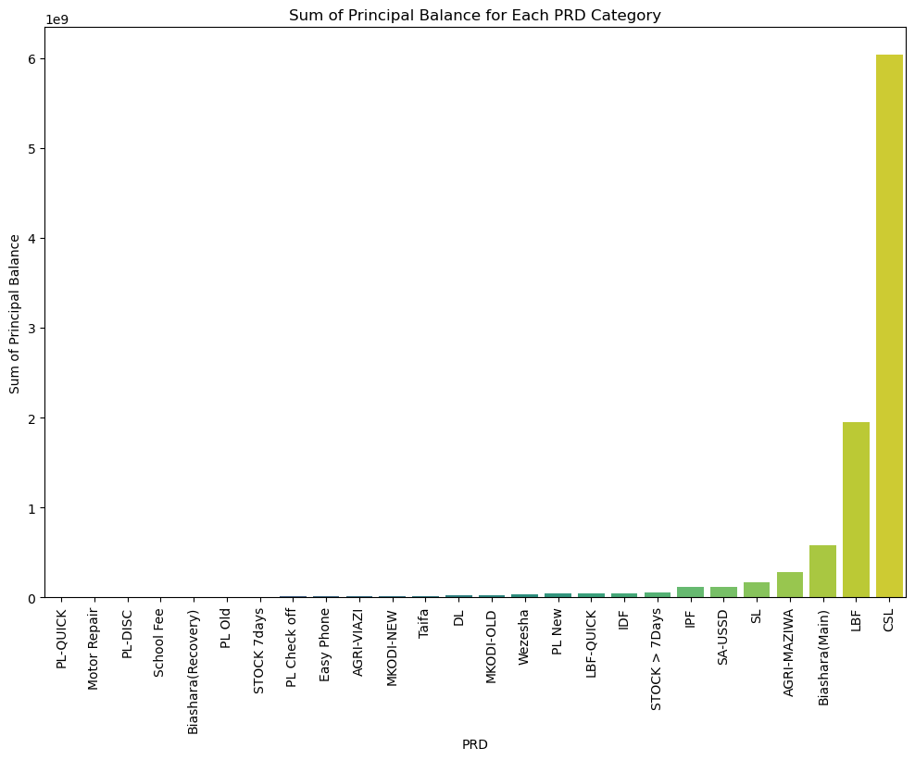
#Sum of principal balance for each product category The company has several products and from the plot CSL is the one leading with the highest followed by LBF, The Bank should focus more boosting the rest of the products so that there can be a balance in event of a future unforeseen economic downtime.

Slide 5
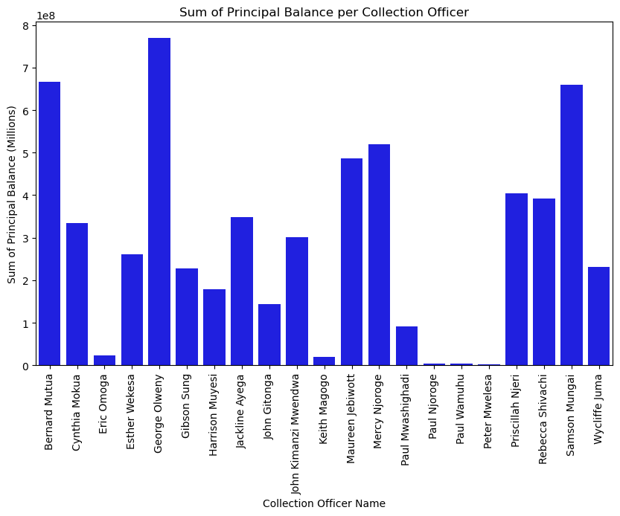
#Pricipal Balance per the collection Officer The bank has several officer responsible for conducting collection, each officer is allocated a portfolio and from the below it shows that some are doing poorly in book retention. They should summoned to identify where the challenge is so that they can be given the necessary support inorder for them to catch up with the rest.

Slide 6
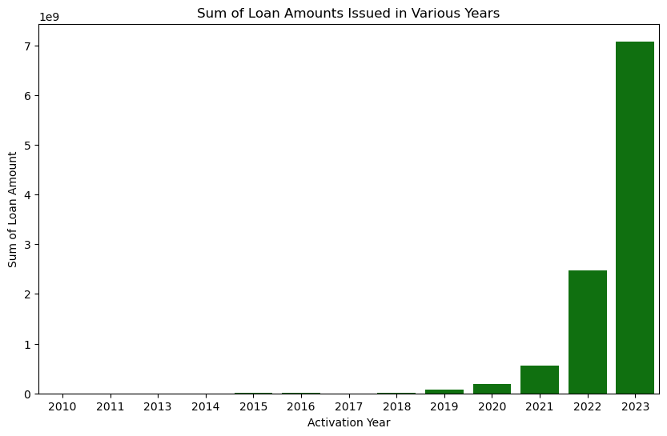
# Trend of loan amounts issued in various years to show if its on the upward trend or downward trend This shows the bank performance over the years from 2010 to date, The Bank has been doing great an indication that they are incresing their market share as the time goes by.2023 seems to be the best year for the Bank.

Slide 7
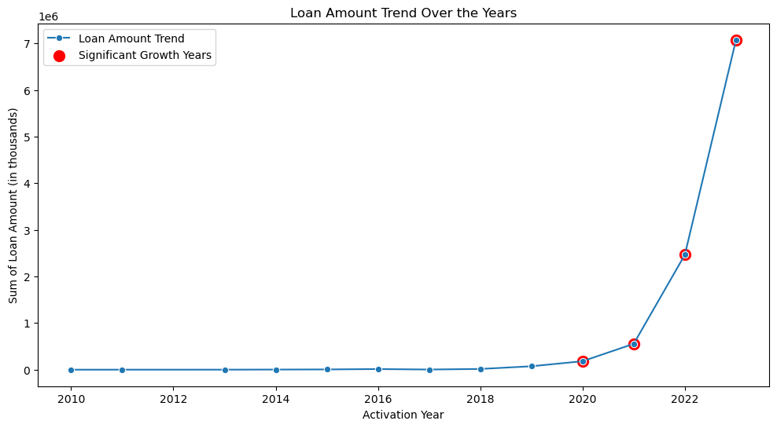
#Loan Amounts Trend over the years This shows the trend of loan amounts over the years an indication that the company is thriving well despite the harsh economic conditions

Slide 8
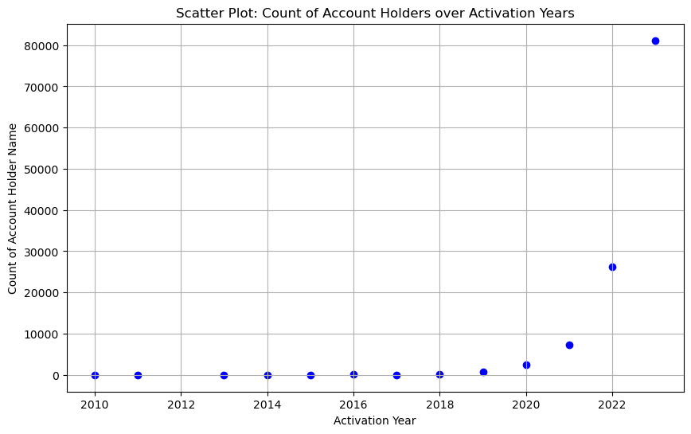
#Trend Count of Account holders over the years This shows the count of clients base and as shown on the previous slide, its an indication that there is a positive corelation between the two.

Slide 9

THANK YOU

